Slide 1
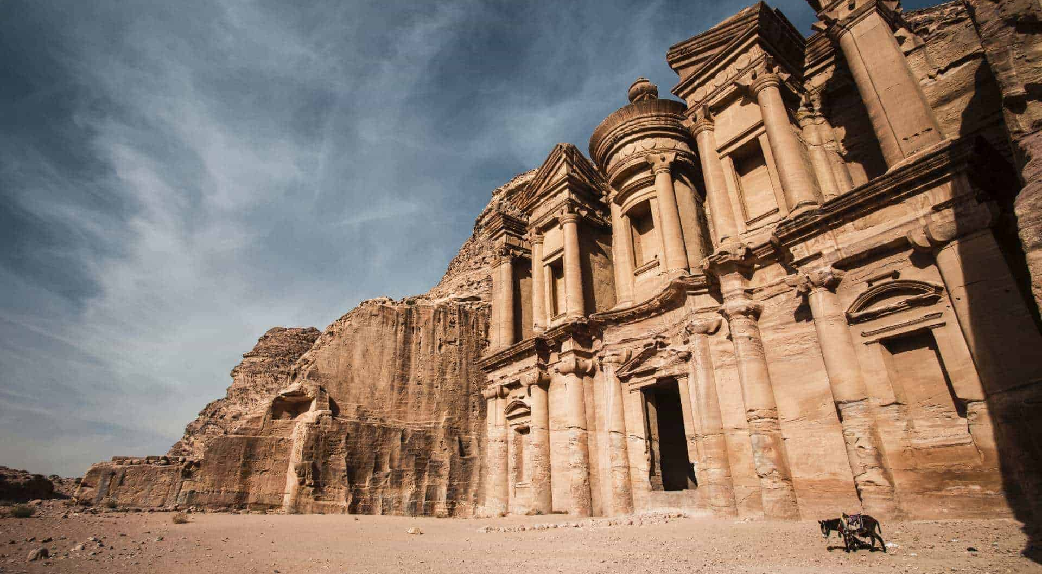
Petra, Jordan

Slide 2
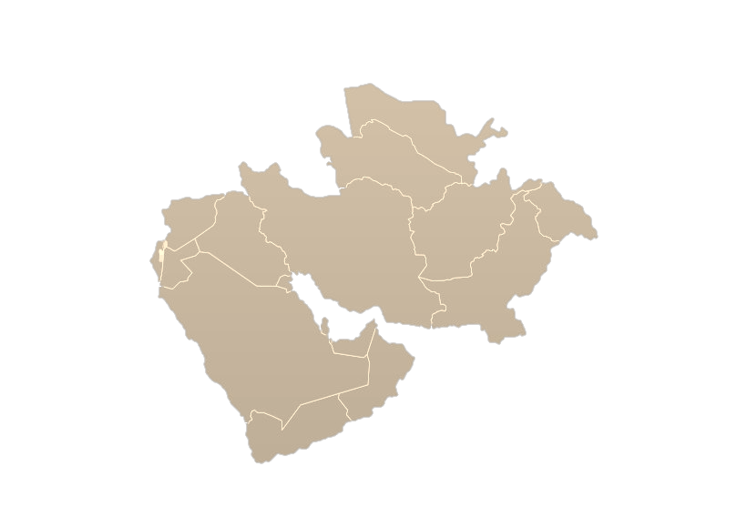
Jordan
Served as an important crossroads between Arabia, Egypt, and Syria-Phoenicia

Slide 3
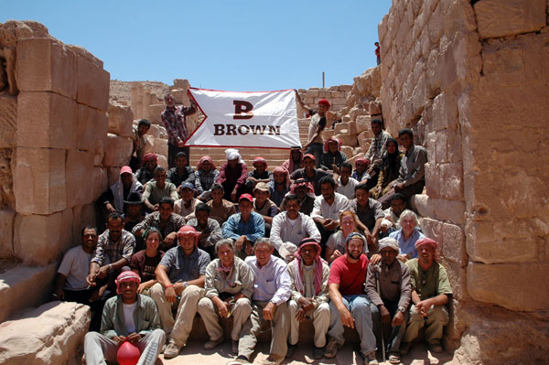
Excavations
“Discovered” by Swiss explorer Johan Ludwig Burckhardt in 1812
Brown University
5% of the buried city has been discovered
15% of the total city

Slide 4
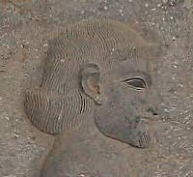
Who were the Nabataeans?
A Bedouin tribe from the Arabian Desert
Gained recognition in the 2nd century BCE
Became a province of the Roman Empire by Trajan in 106 CE
They are believed to have originated in Yemen
One of the only culturally prominent tribes in Arabia
Eventually became its own kingdom

Slide 5
Petra falls under Islamic rule (600s CE)
Height of the settlement, kingdom status (50 BCE-50 CE)
Constantine moves the capital to the East (330 CE)
Settle in Petra (300-200 BCE)
Earthquake hits Petra (363 CE)
Nabataeans become major players in international trade (100 BCE)
Rome takes Petra as a province (106 CE)
Christianity reaches Petra (350 CE)
Romans lose control (300s CE)
Western Explorers “rediscover” Petra (1812 CE)

Slide 6
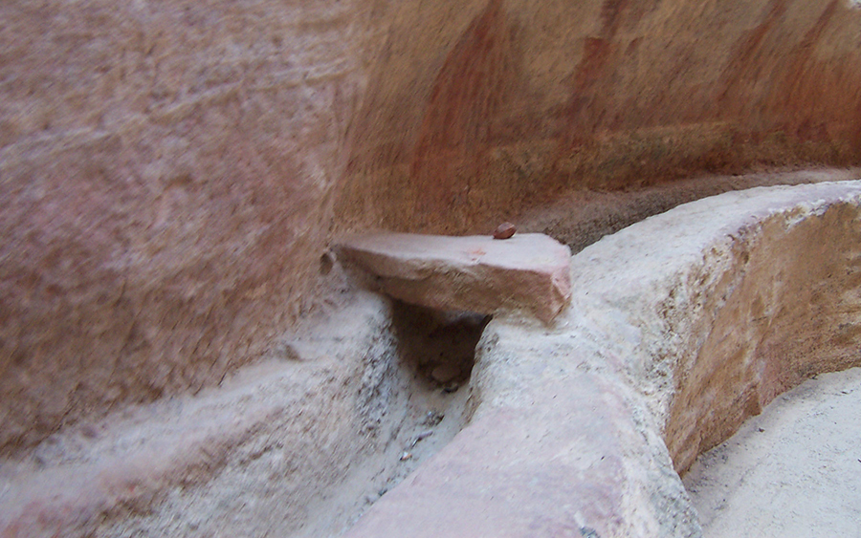
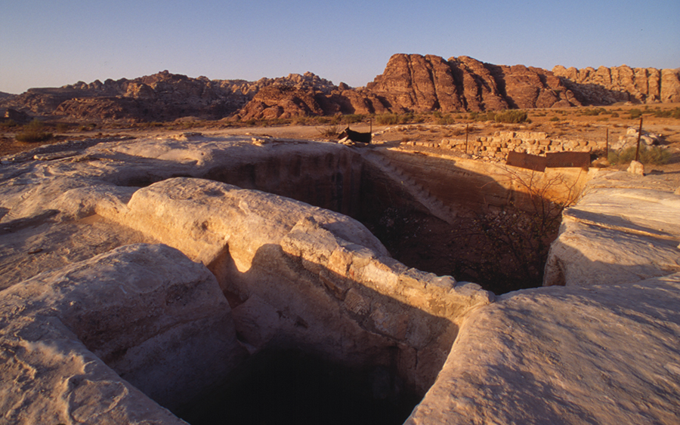
Origins
Taxes were placed on all trade
Exposure to various other peoples
Petra was home to a complex system of channels, dams, and cisterns
These were either cut from rock or were underground water pipes
Water sources included springs and streams

Slide 7
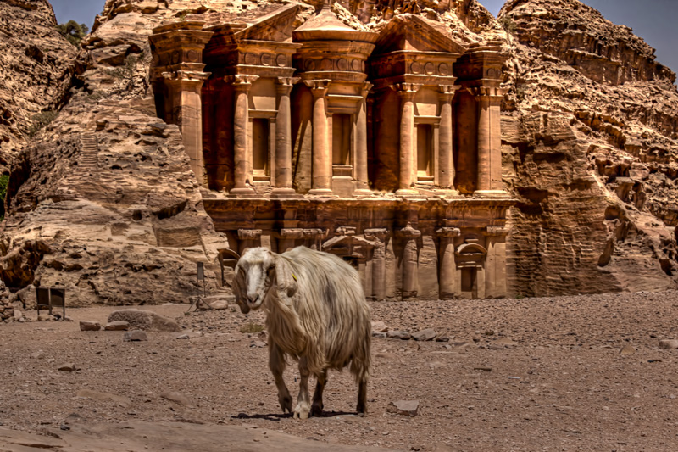
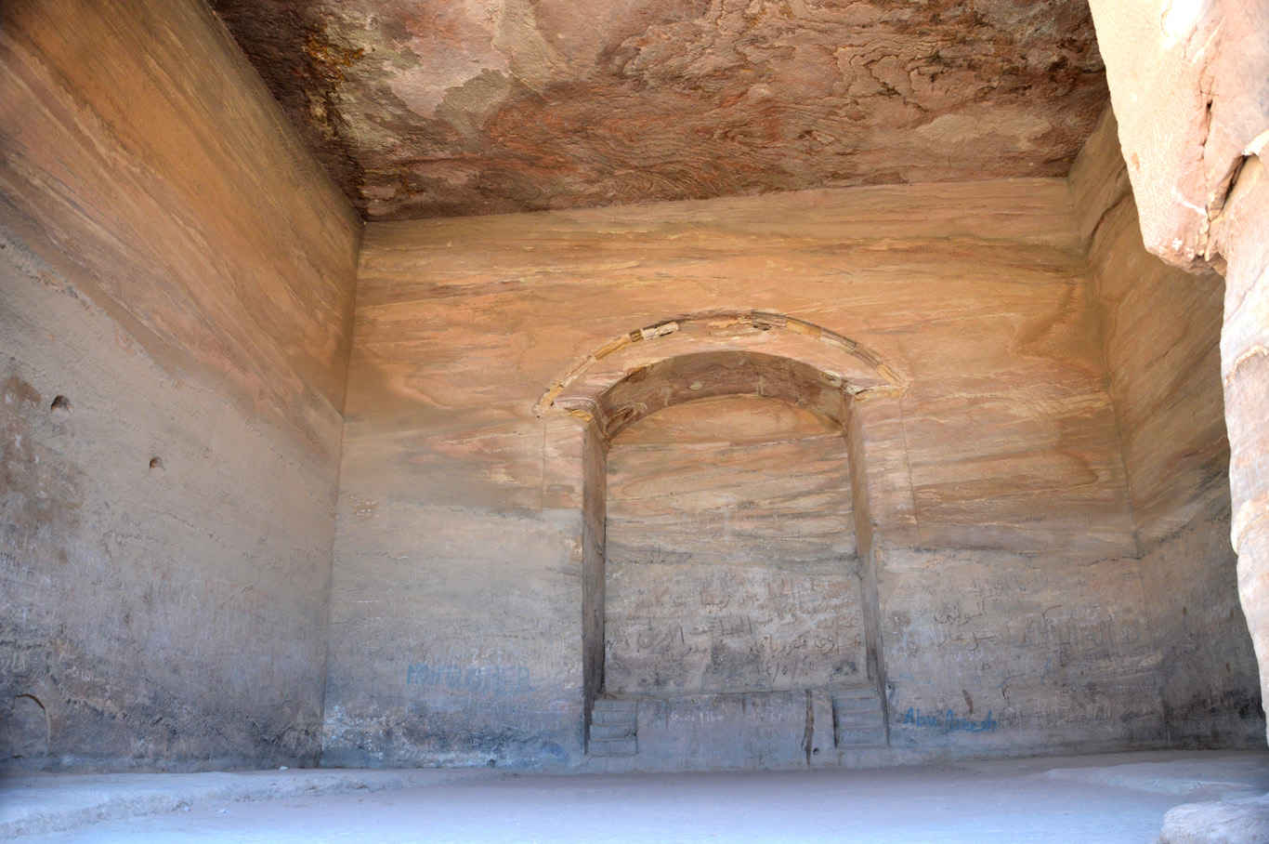
The Monastery (Al Deir)
Most likely built in the mid first century CE
48 meters tall and 47 meters wide
Interior is one large room
Corinthian columns and Doric entablature
Dedicated to Obodas I
Repurposed as a Christian church

Slide 8
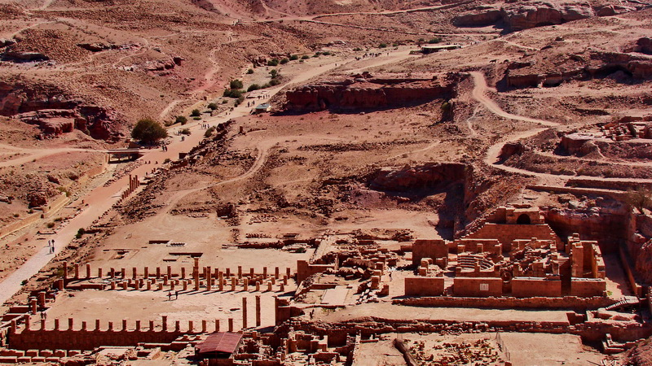
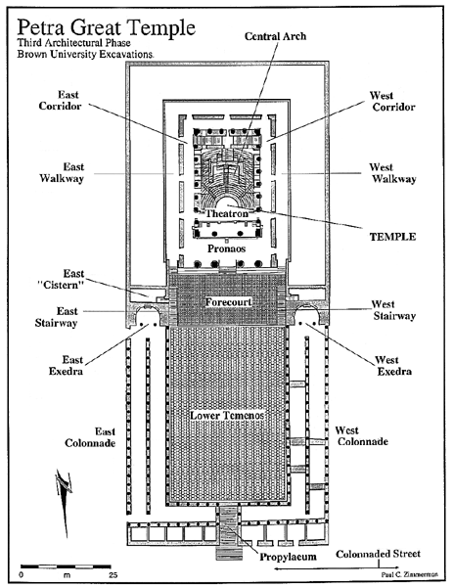
Great Temple
Central Petra
Built late first first century BCE
7560 square meters
Earthquakes

Slide 9
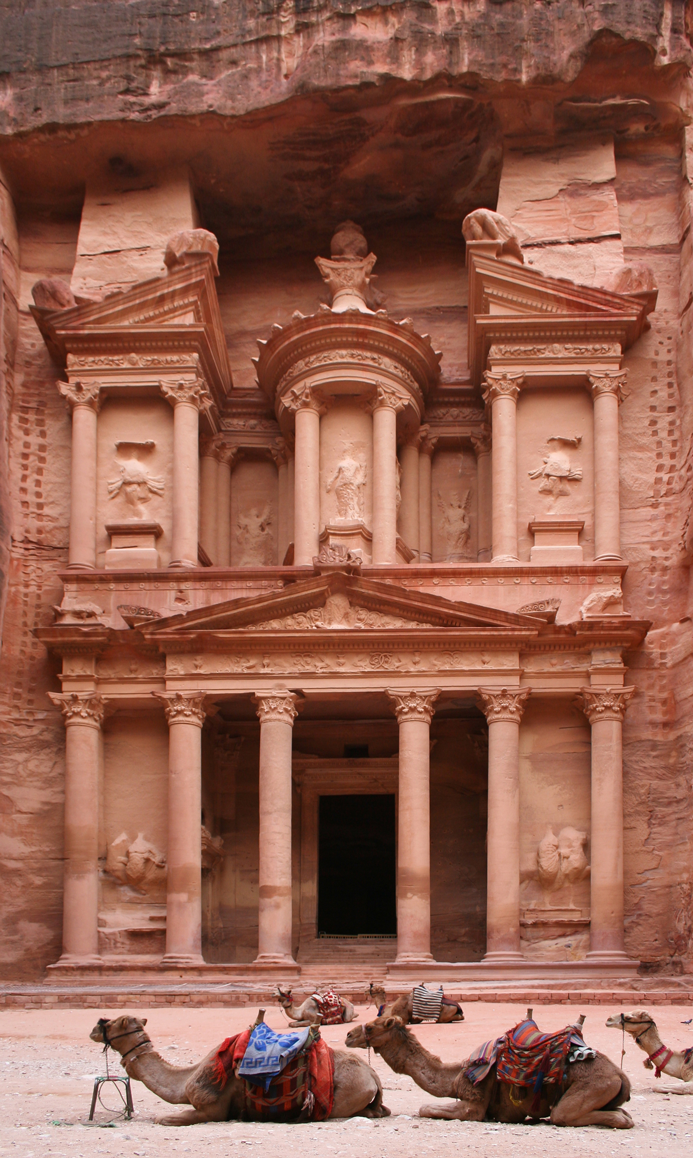
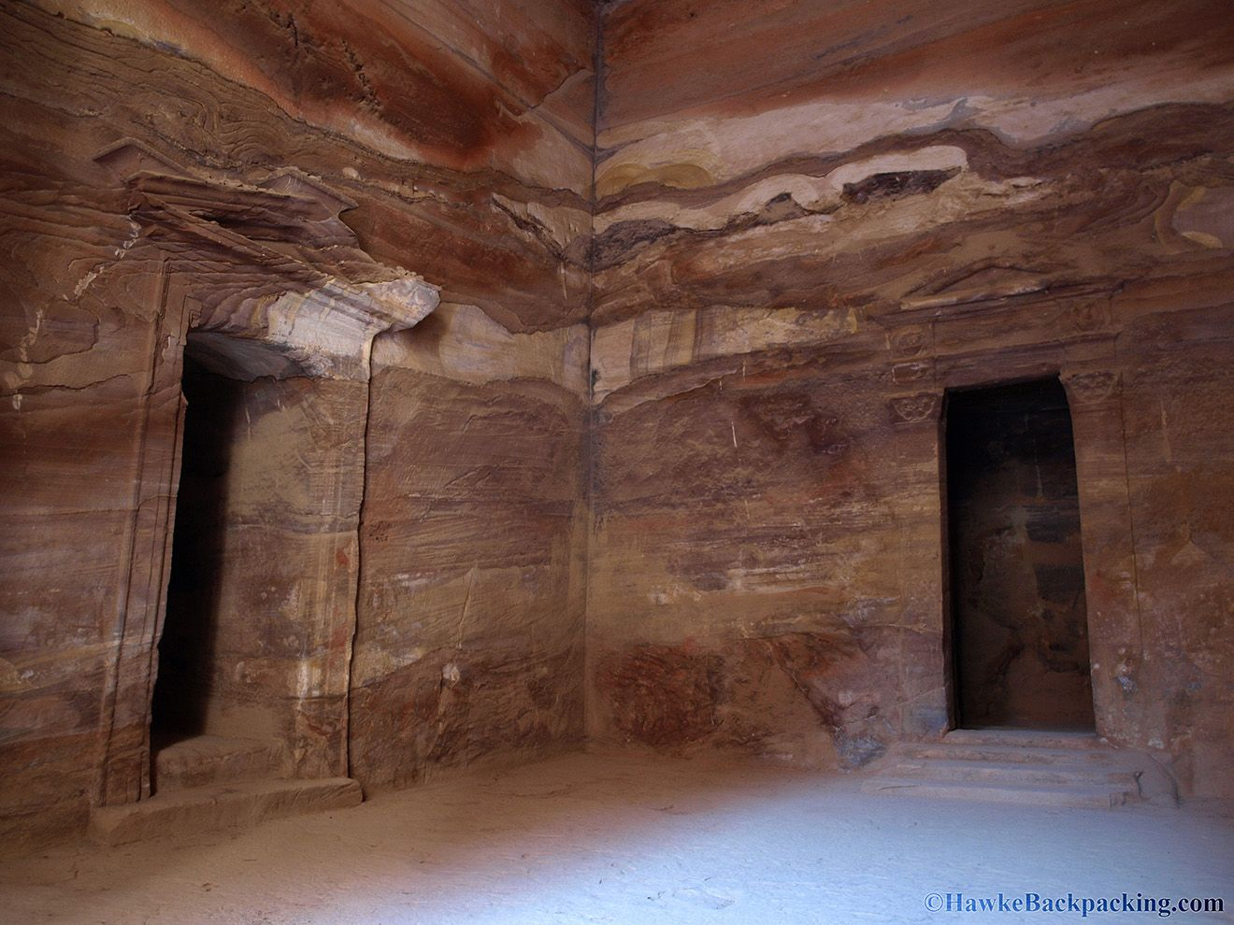
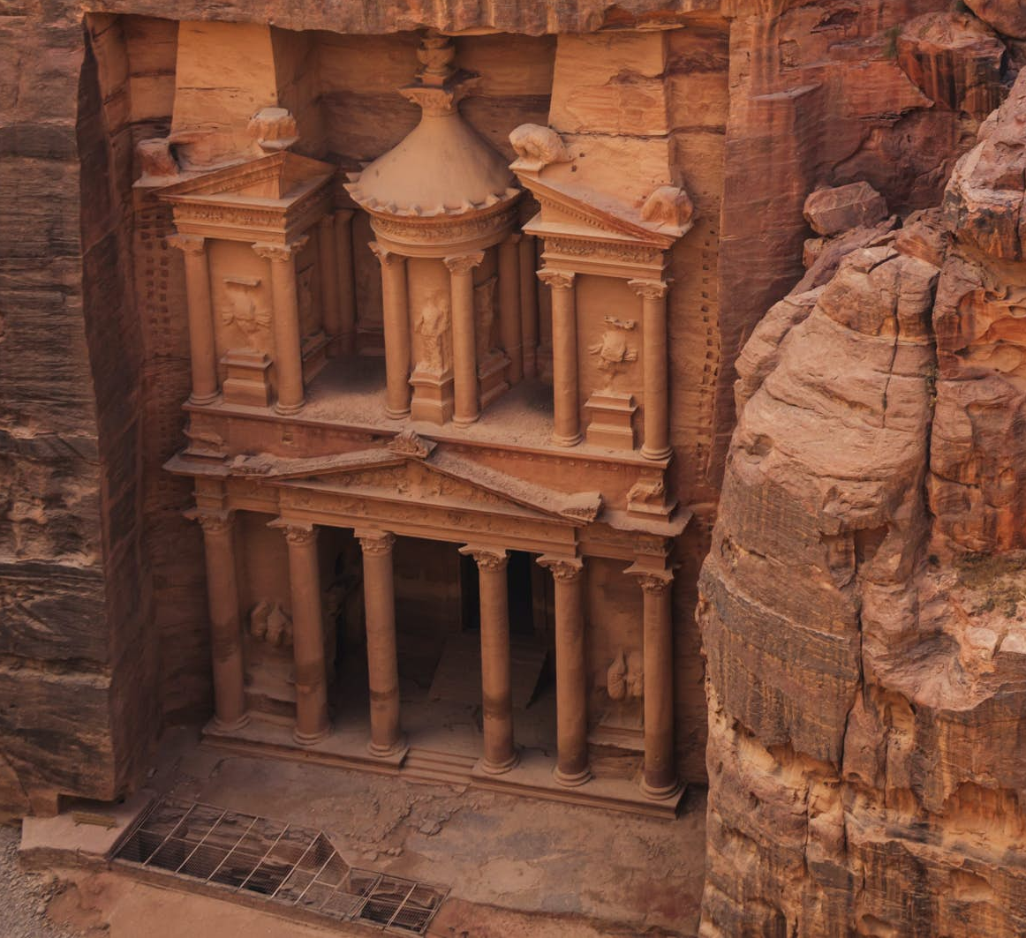
The Treasury (Al-Khazneh)
40 meters tall
Constructed in the first century BCE
Two floors
Corinthian capitals and friezes
Funerary urn
Purpose varies from tombs to document storage

Slide 10
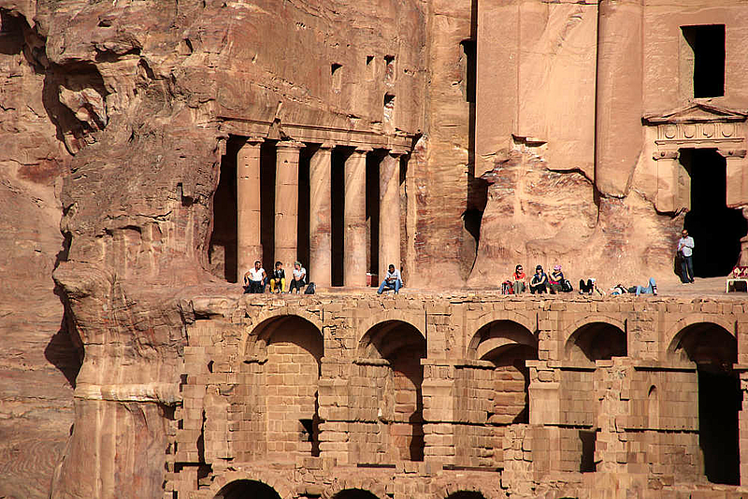
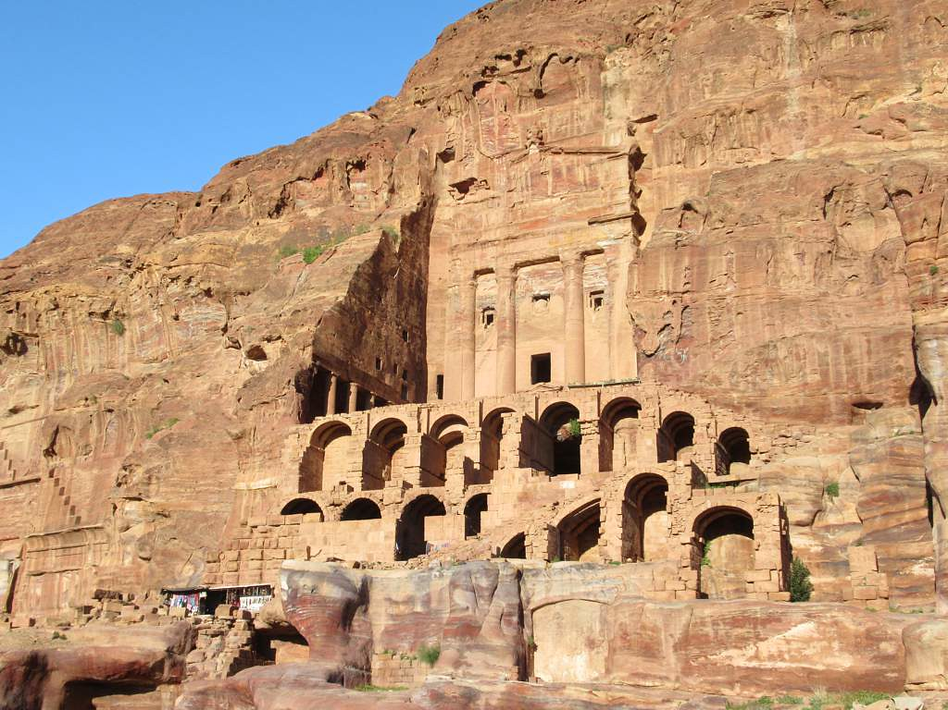
Urn Tomb
Built c. 70 AD
Tomb of Malchus II
Two levels of vaults
3 niches on the façade lead to small burial chambers
Colonnaded courtyard
Converted to a church in 447 AD by Bishop Jason

Slide 11
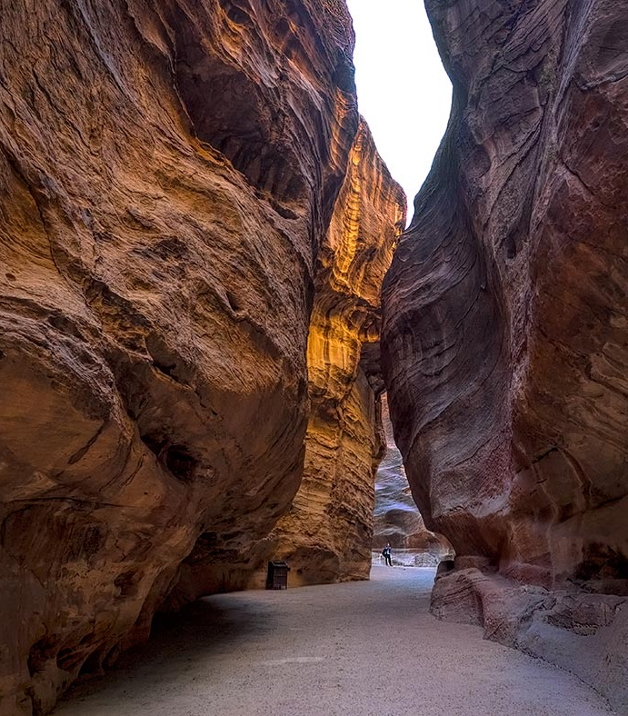
The Road (Siq)
1200 meters long and up to 80 meters tall
Natural
Some spots were decorated
Water channels on either side

Slide 12
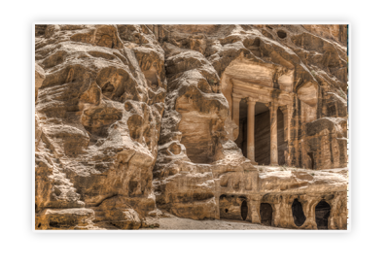
Little Petra (Al-Beidha)
Neolithic (7200 BCE-6500 BCE)
One of the first known settled villages in history
Only inhabited for a short time
Remains of agrarian techniques
Domesticated animals

Slide 13
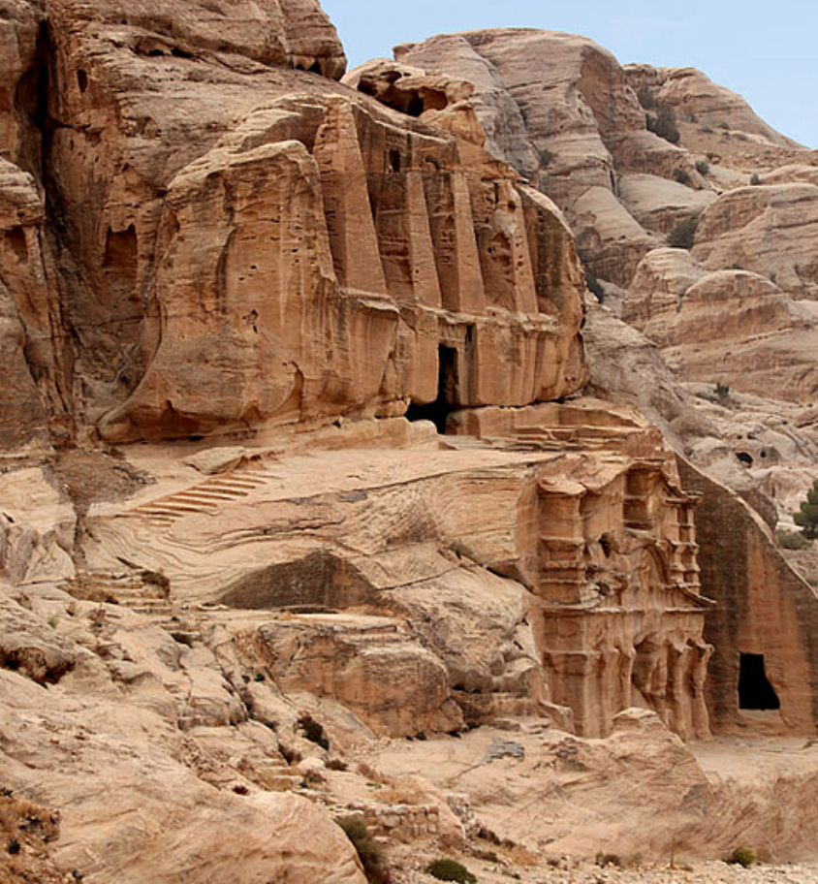
Obelisk Tomb
Burial complex
Built between 40 and 70 CE
Reliefs depicting the deceased
Named after the 4 obelisks (nefeshes)
4 graves
Also holds a basin and cistern

Slide 14
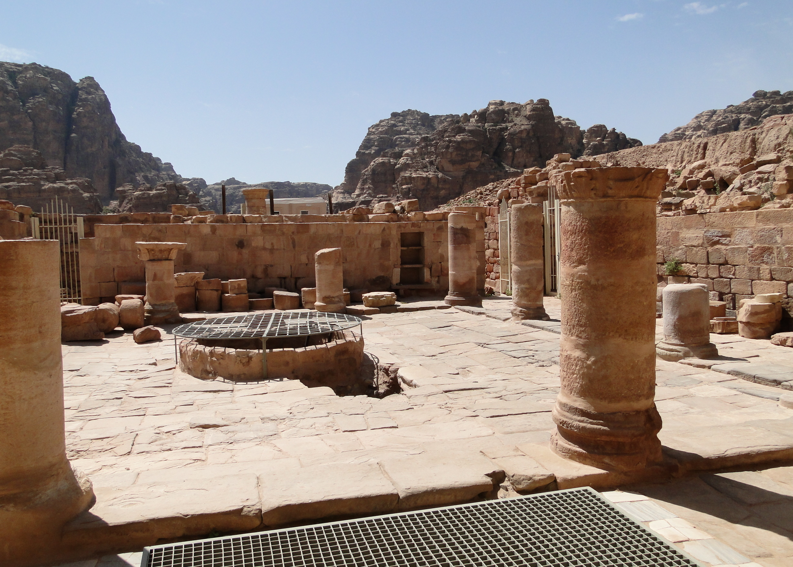
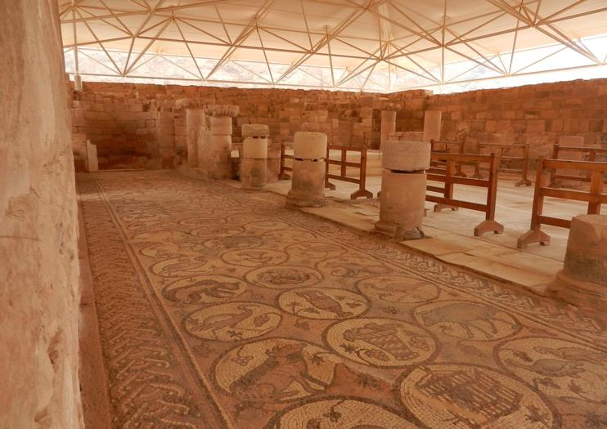
Byzantine Church
Triple Basilica
Includes a stone paved atrium
Various well preserved mosaics
152 papyrus scrolls were uncovered in 1993 in a storage room
Carbonized
Belong to a single family
Built in 450 AD
Destroyed by fire in c. 600 AD

Slide 15
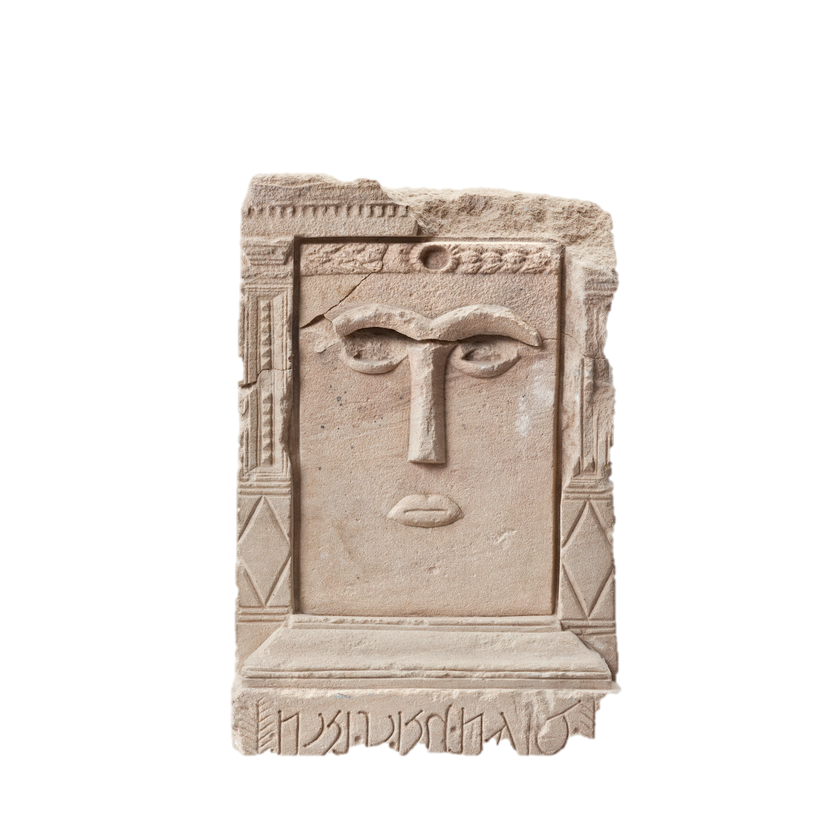
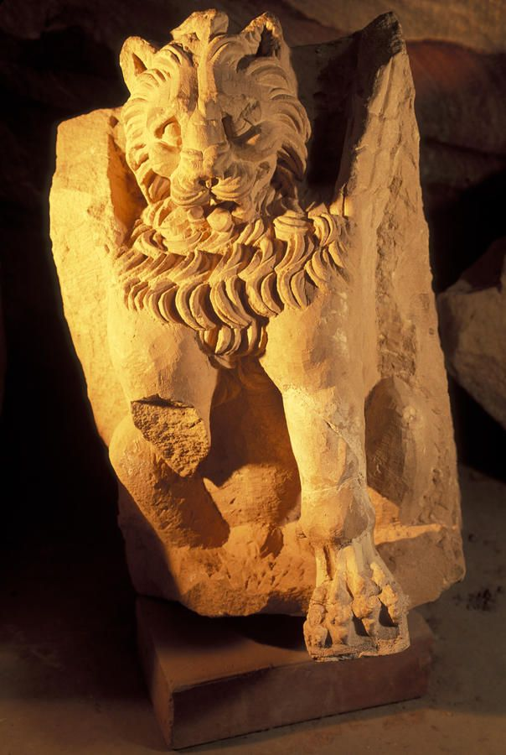
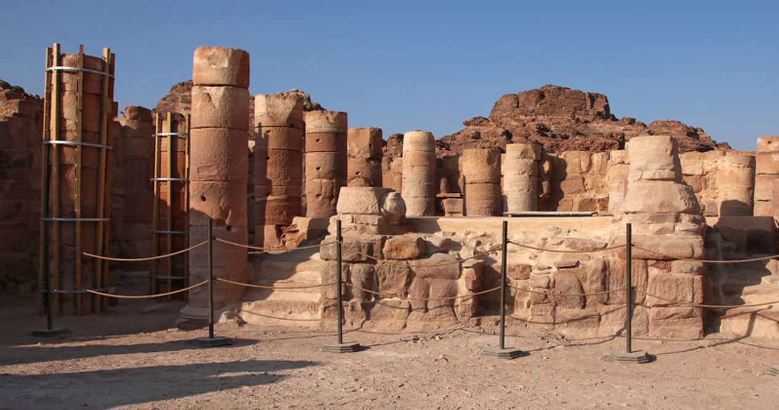
Temple of the Winged Lions
Nabataean cult complex
Faces the Great Temple
Dedicated to Allat (parallel to Isis and Aphrodite)
Destroyed in 363 CE

Slide 16
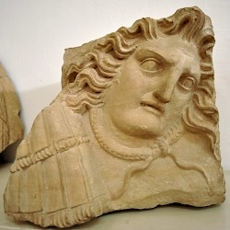
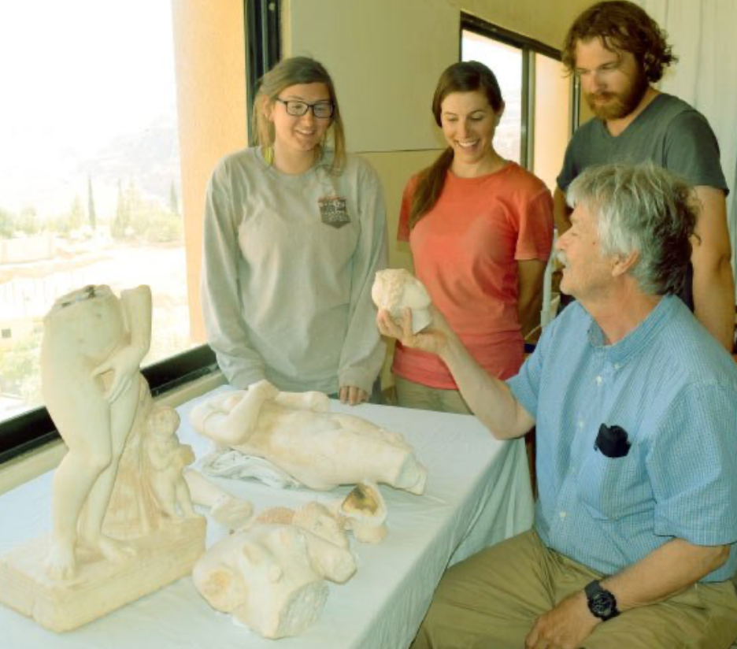
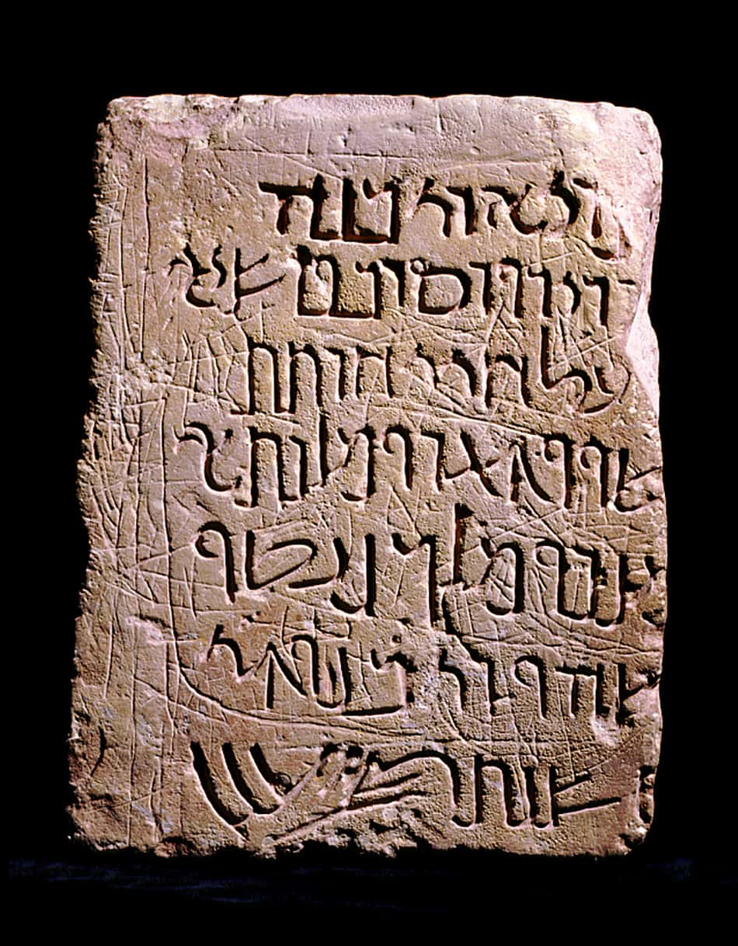
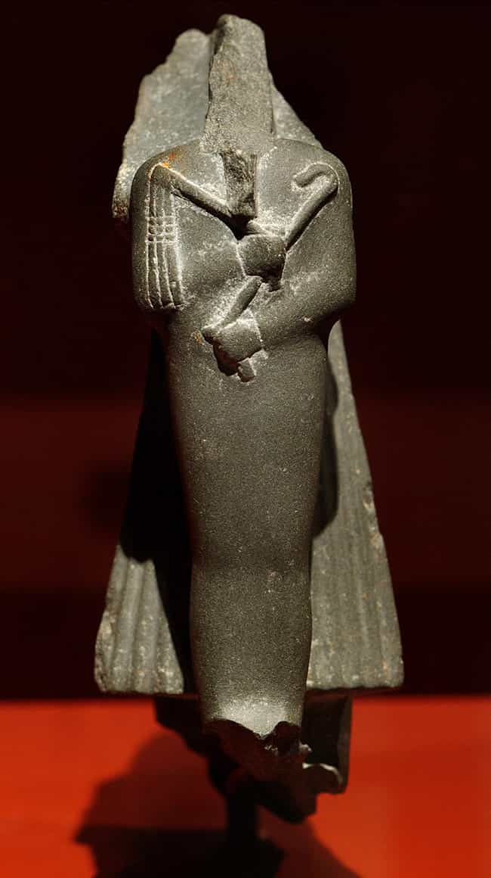
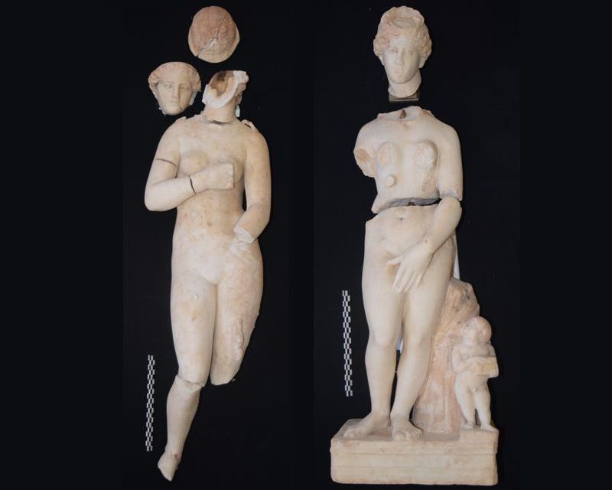
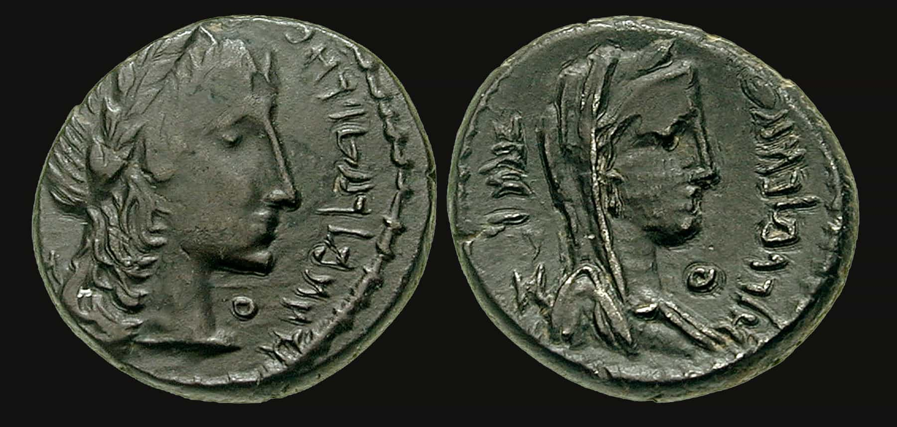
Artifacts

Slide 17
Bibliography
Art Destination Jordan. https://universes.art/en/art-destinations/jordan. Accessed 8 Apr. 2021.
Beyond Petra - Archaeology Magazine. https://www.archaeology.org/issues/360-1911/letter-from/8076-jordan-petra-hinterland. Accessed 5 Apr. 2021.
Brown University Petra Archaeological Project. https://brown.edu/Departments/Joukowsky_Institute/fieldwork/bupap/8445.html. Accessed 5 Apr. 2021.
Centre, UNESCO World Heritage. “Petra.” UNESCO World Heritage Centre, https://whc.unesco.org/en/list/326/. Accessed 5 Apr. 2021.
“Petra Archaeological Site.” World Monuments Fund, https://www.wmf.org/project/petra-archaeological-site. Accessed 5 Apr. 2021.
Petra Great Temple - Archaeology Magazine Archive. https://archive.archaeology.org/online/features/jordan/. Accessed 5 Apr. 2021.
Visit Petra - Home Page. https://www.visitpetra.jo/Default.aspx. Accessed 8 Apr. 2021.

